Slide 1

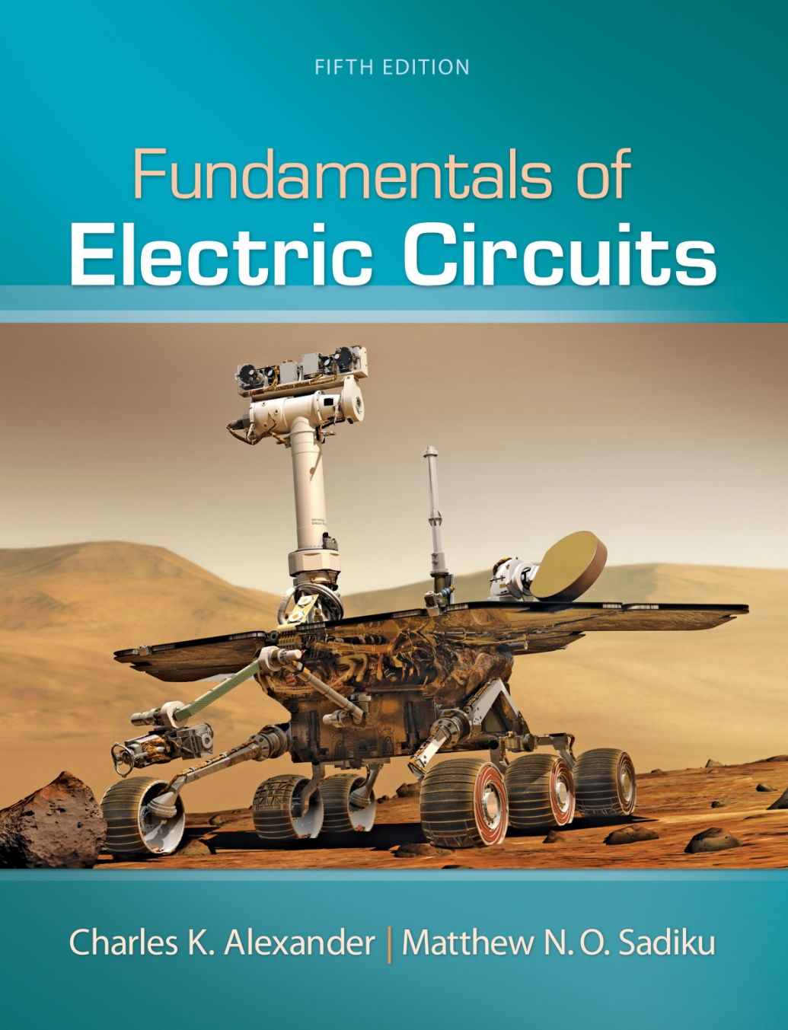
Fundamentals of
Electric Circuits
Chapter 6
Copyright © The McGraw-Hill Companies, Inc. Permission required for reproduction or display.

Slide 2

Page 215

Slide 3
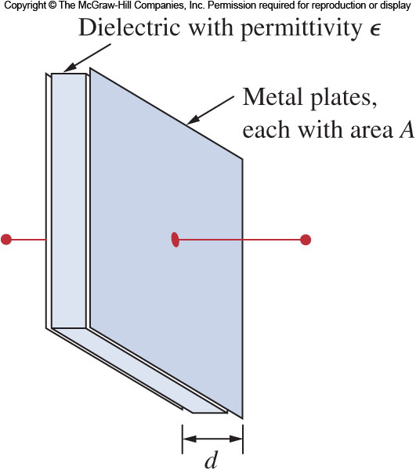
Figure 6.1

Slide 4
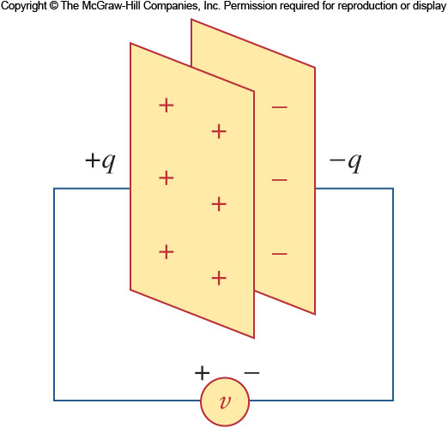
Figure 6.2

Slide 5
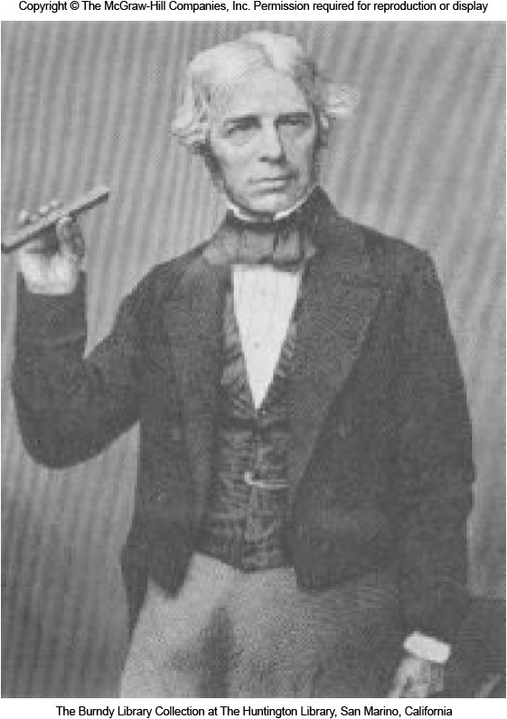
Page 217

Slide 6
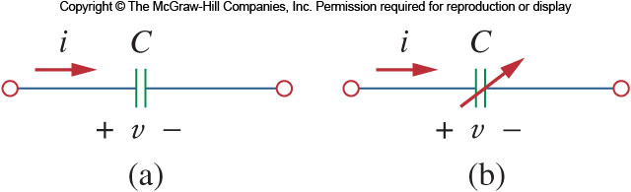
Figure 6.3

Slide 7
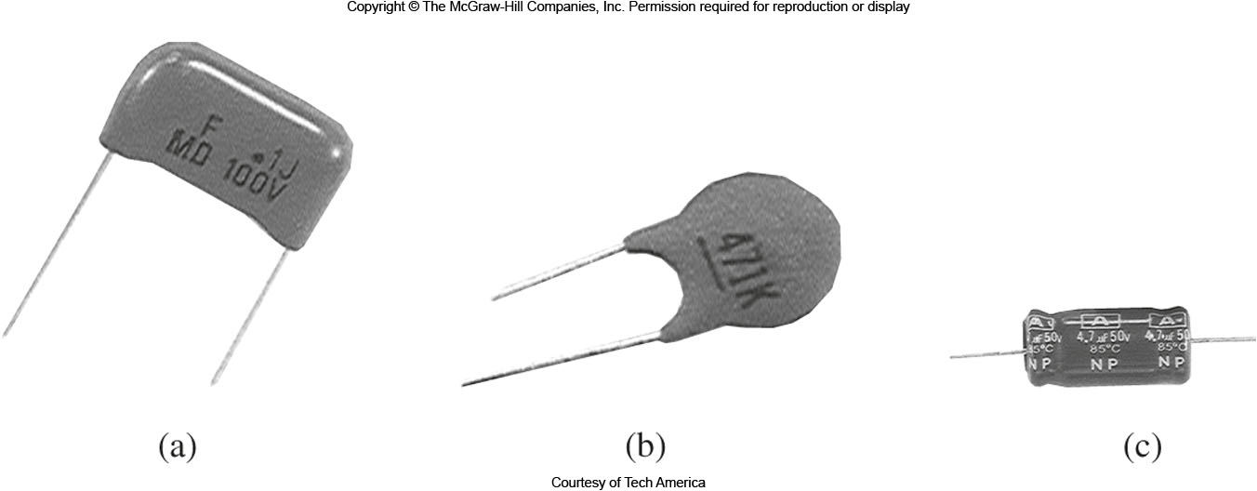
Figure 6.4

Slide 8
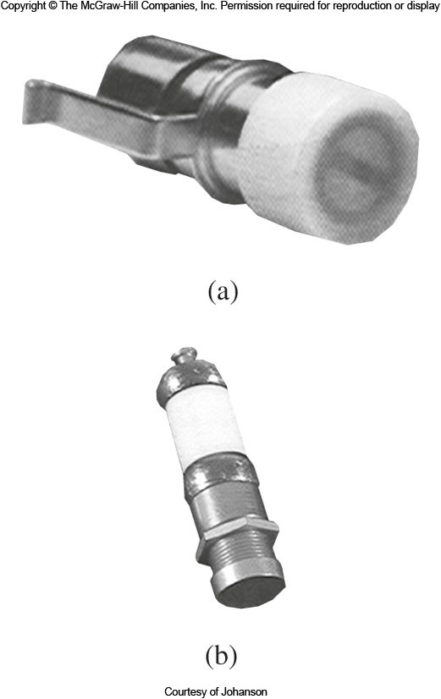
Figure 6.5

Slide 9
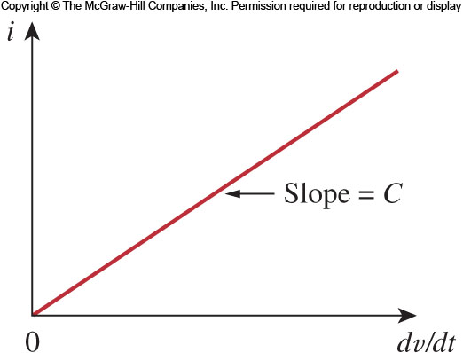
Figure 6.6

Slide 10
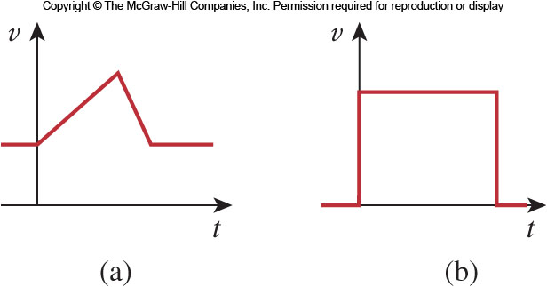
Figure 6.7

Slide 11
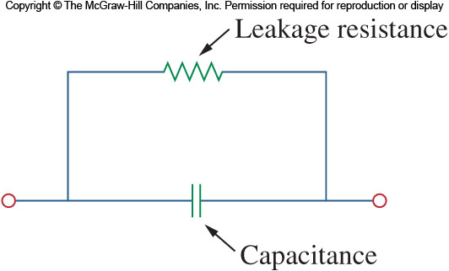
Figure 6.8

Slide 12
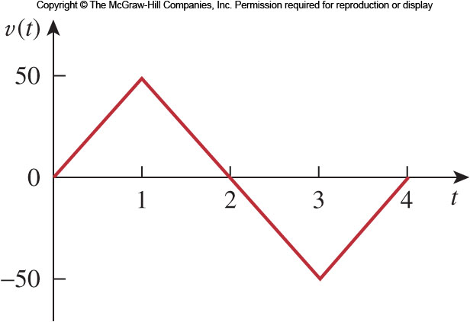
Figure 6.9

Slide 13
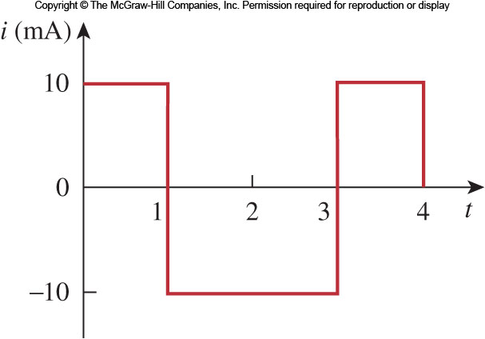
Figure 6.10

Slide 14
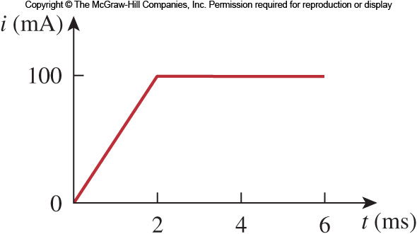
Figure 6.11

Slide 15
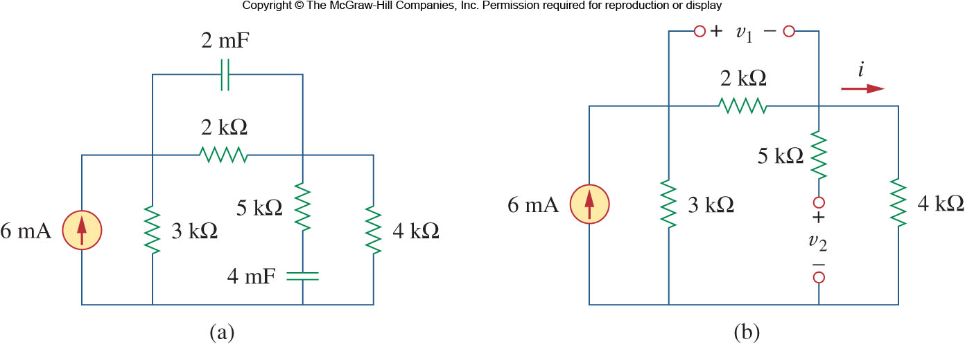
Figure 6.12

Slide 16
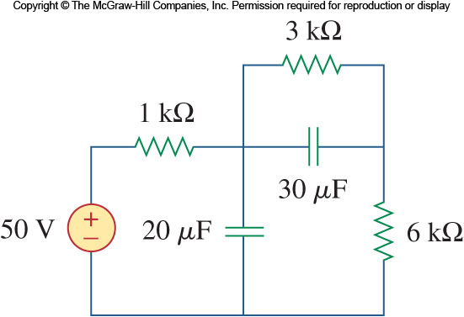
Figure 6.13

Slide 17
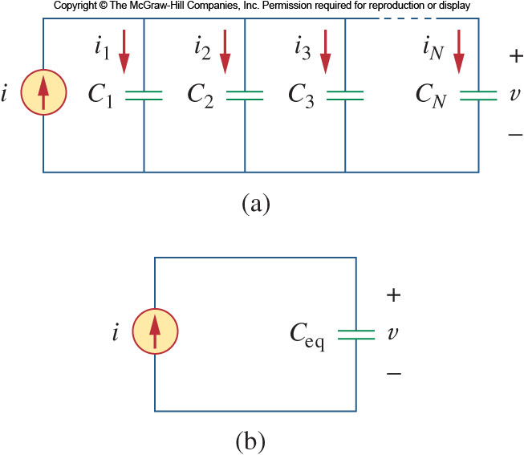
Figure 6.14

Slide 18
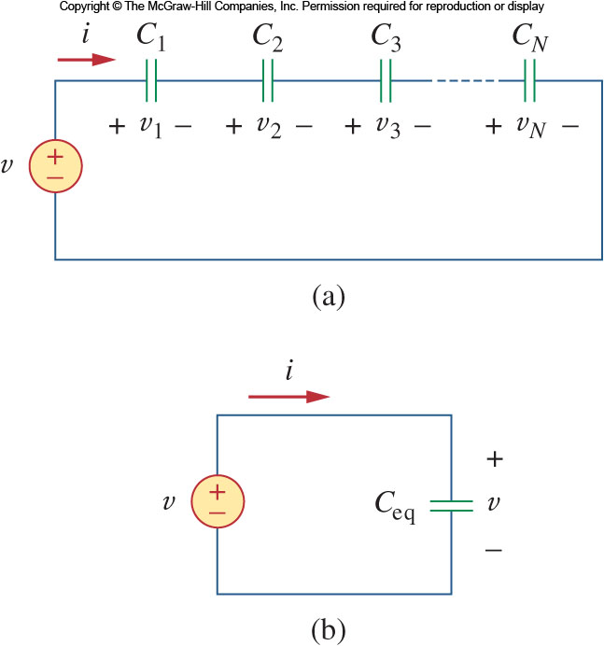
Figure 6.15

Slide 19
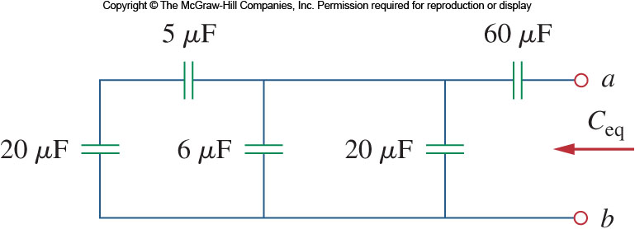
Figure 6.16

Slide 20
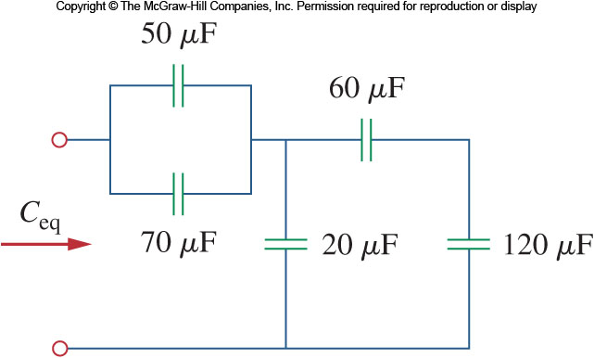
Figure 6.17

Slide 21
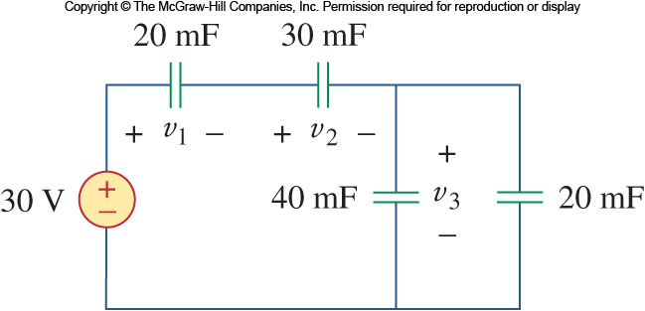
Figure 6.18

Slide 22
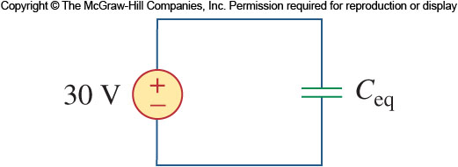
Figure 6.19

Slide 23
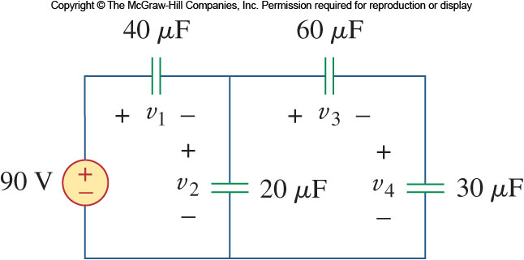
Figure 6.20

Slide 24
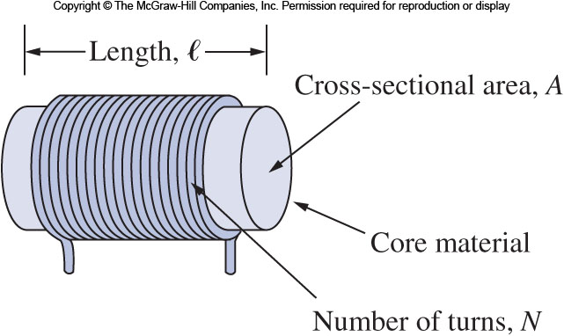
Figure 6.21

Slide 25
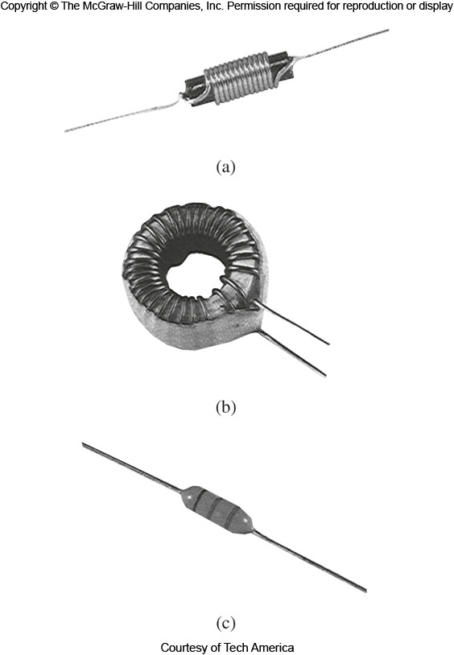
Figure 6.22

Slide 26
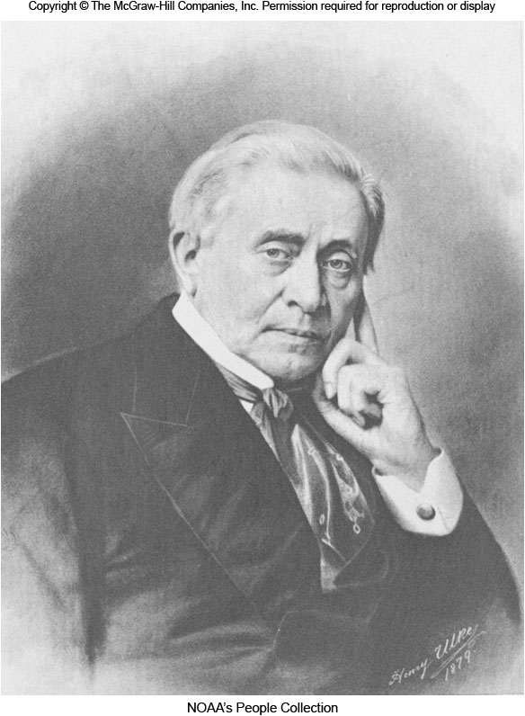
Page 227

Slide 27
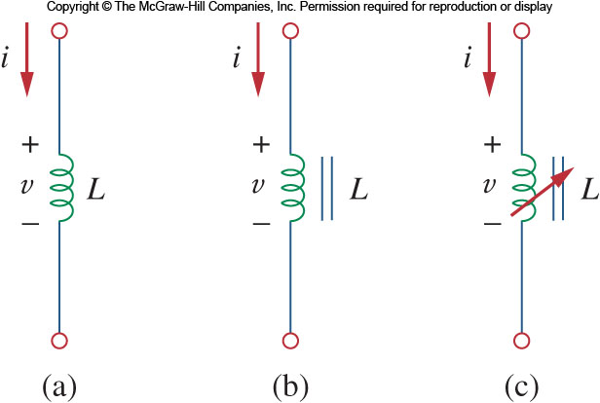
Figure 6.23

Slide 28
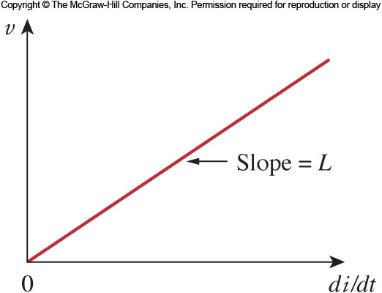
Figure 6.24

Slide 29
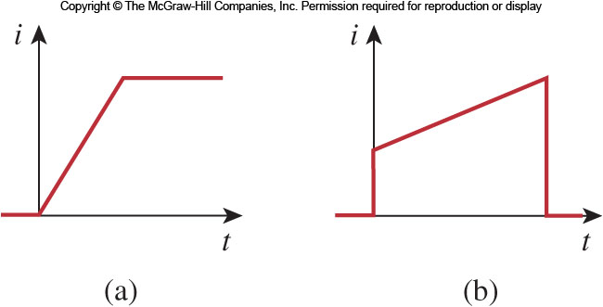
Figure 6.25

Slide 30
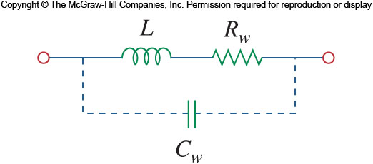
Figure 6.26

Slide 31
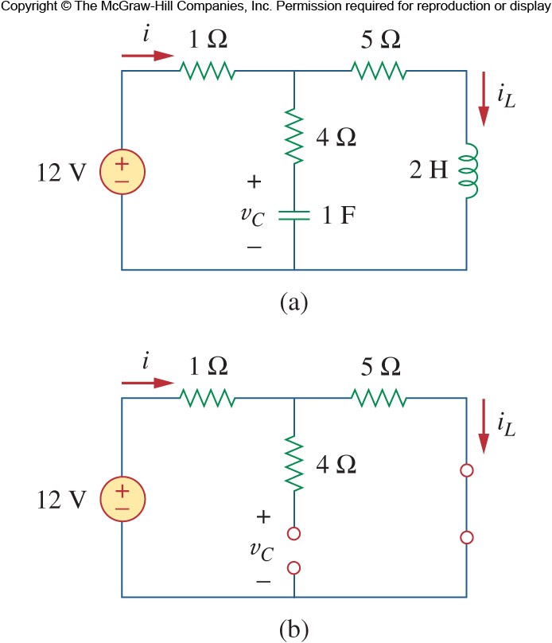
Figure 6.27

Slide 32
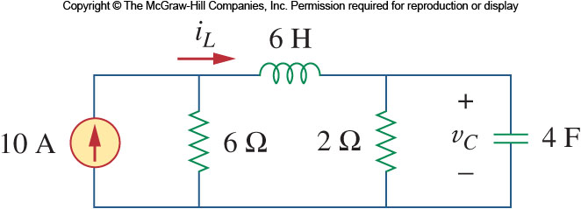
Figure 6.28

Slide 33
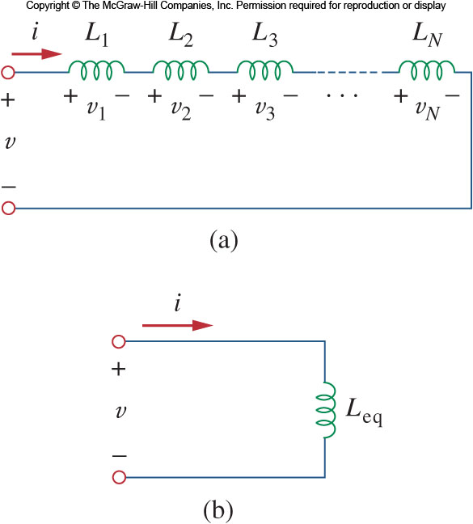
Figure 6.29

Slide 34
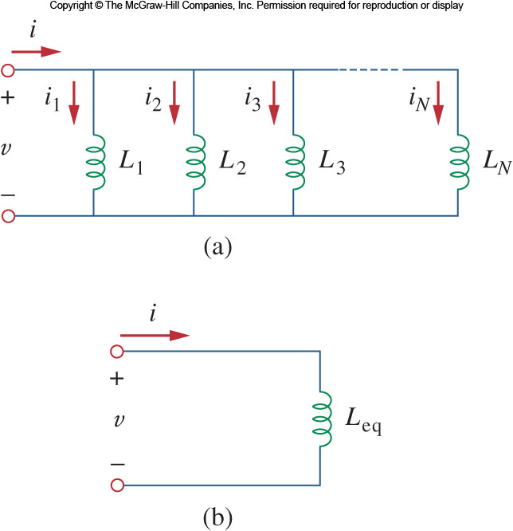
Figure 6.30

Slide 35
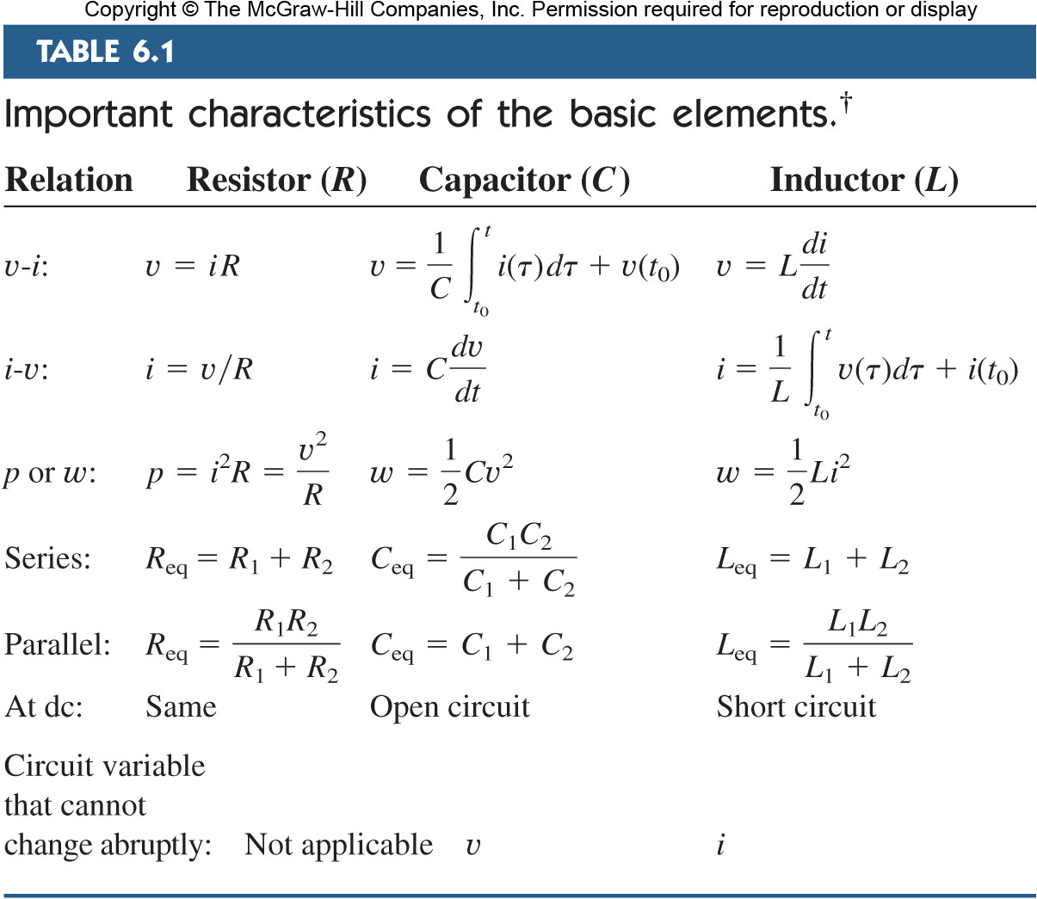
Table 6.1

Slide 36
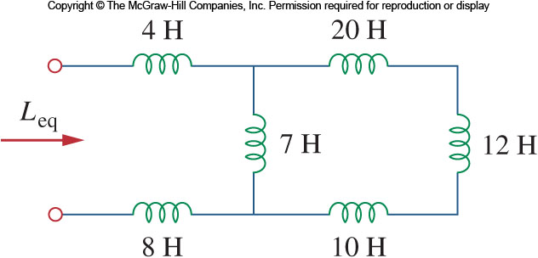
Figure 6.31

Slide 37
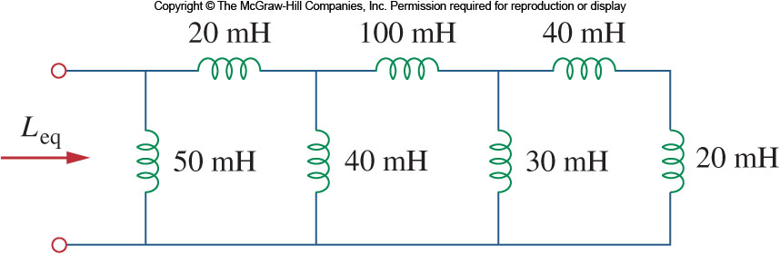
Figure 6.32

Slide 38
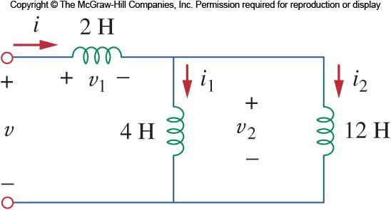
Figure 6.33

Slide 39
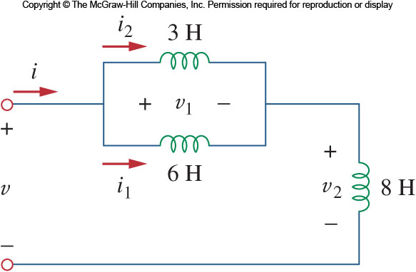
Figure 6.34

Slide 40
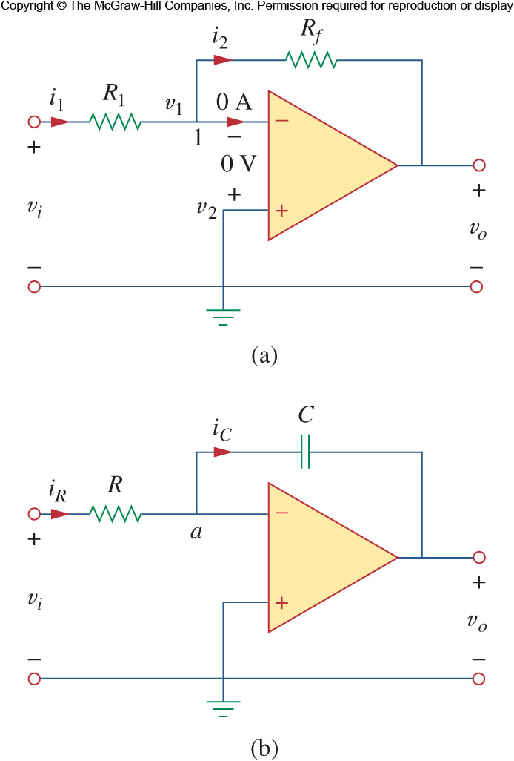
Figure 6.35

Slide 41
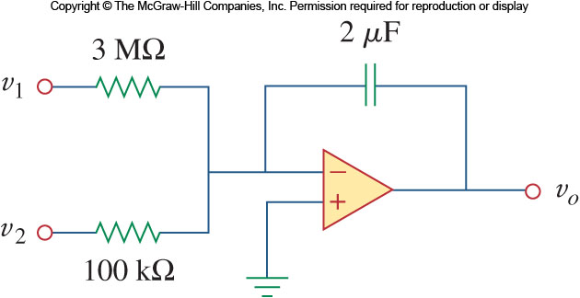
Figure 6.36

Slide 42
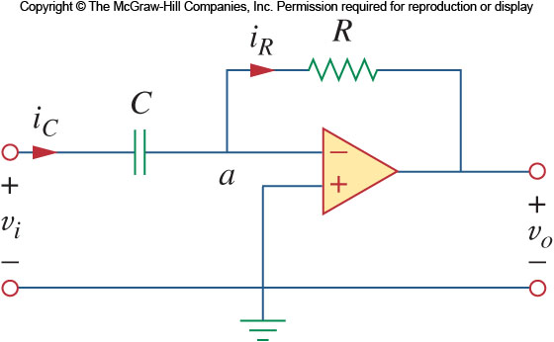
Figure 6.37

Slide 43
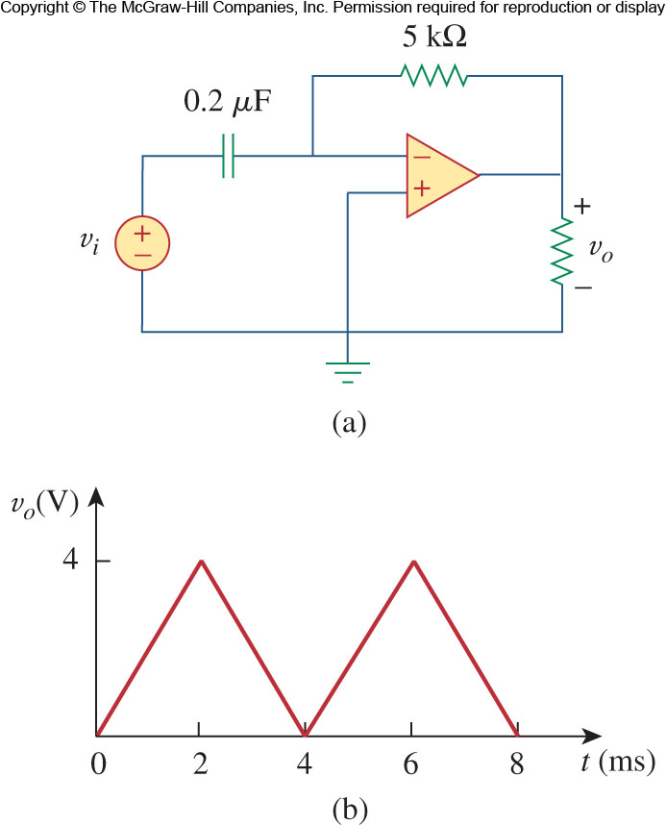
Figure 6.38

Slide 44
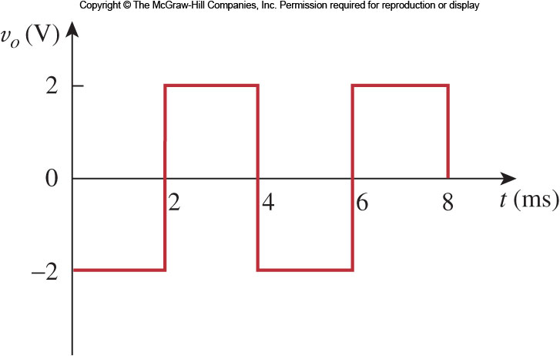
Figure 6.39

Slide 45
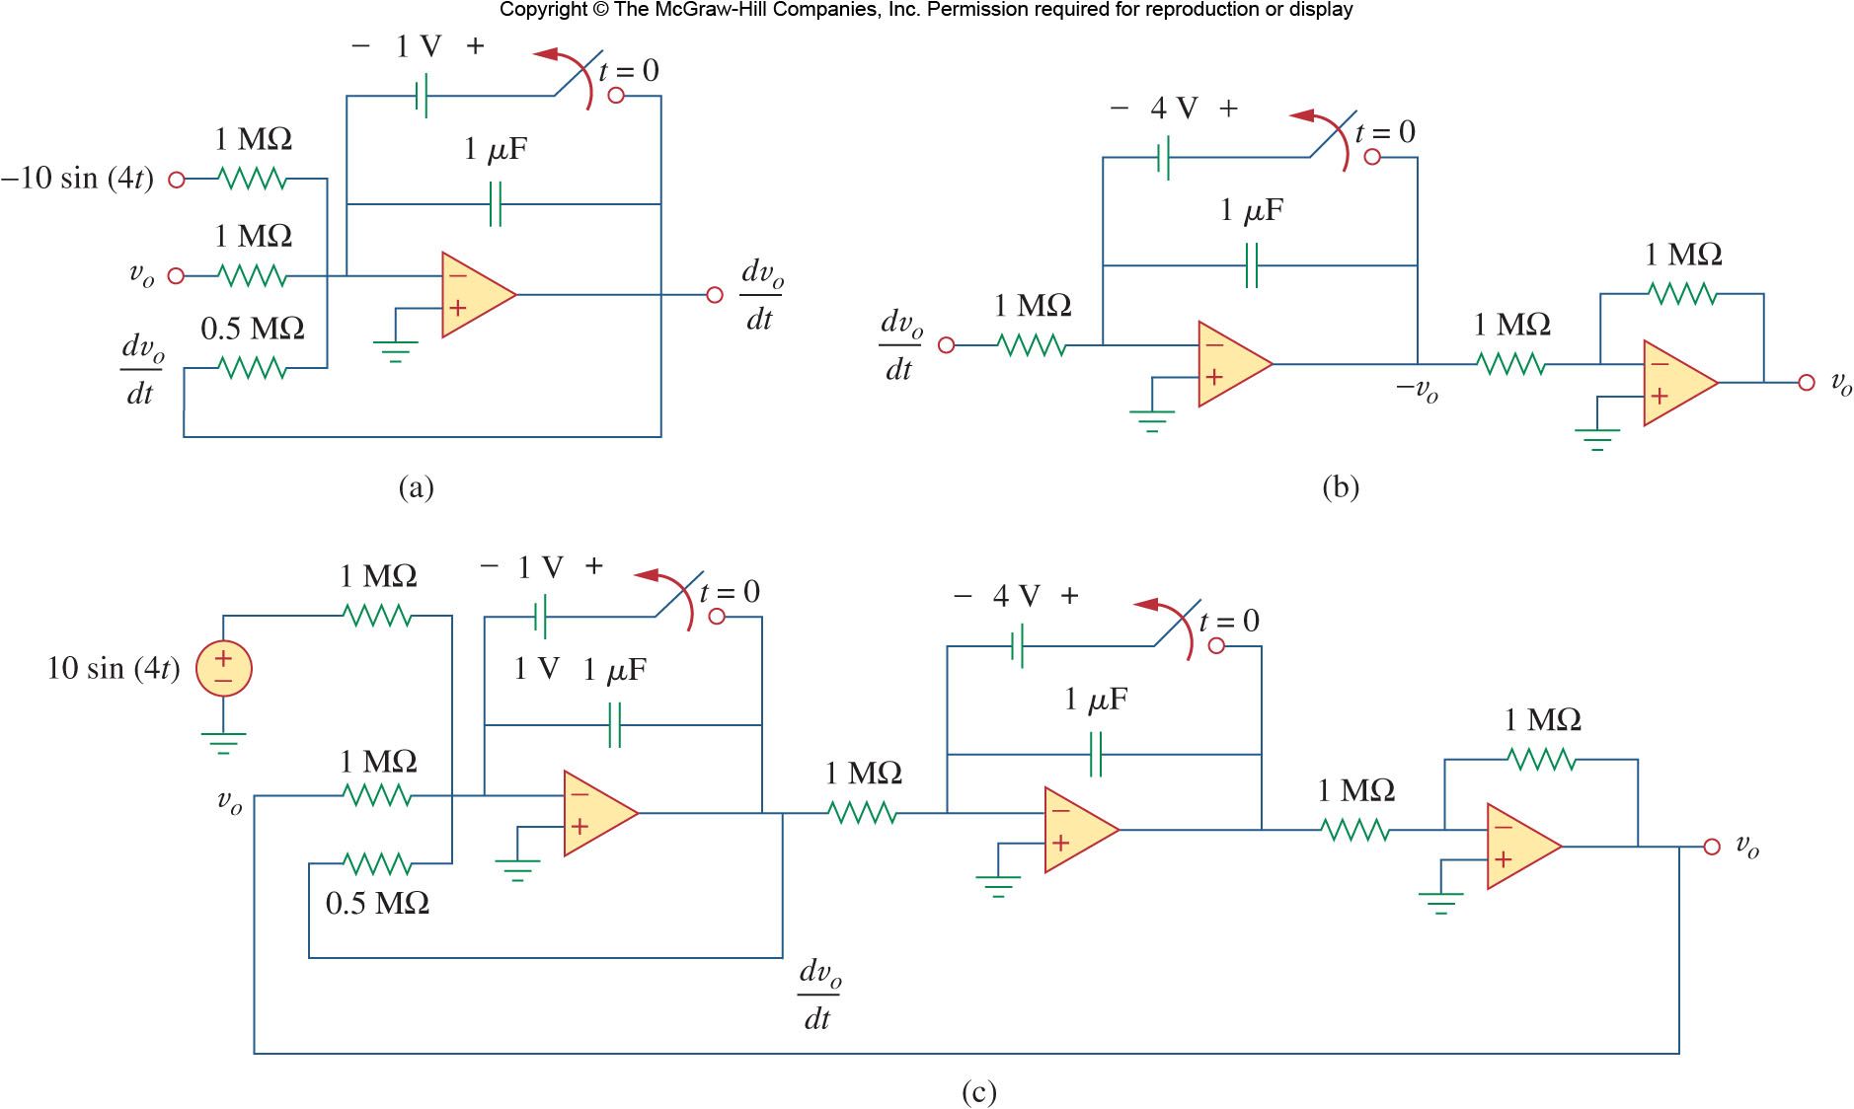
Figure 6.40

Slide 46
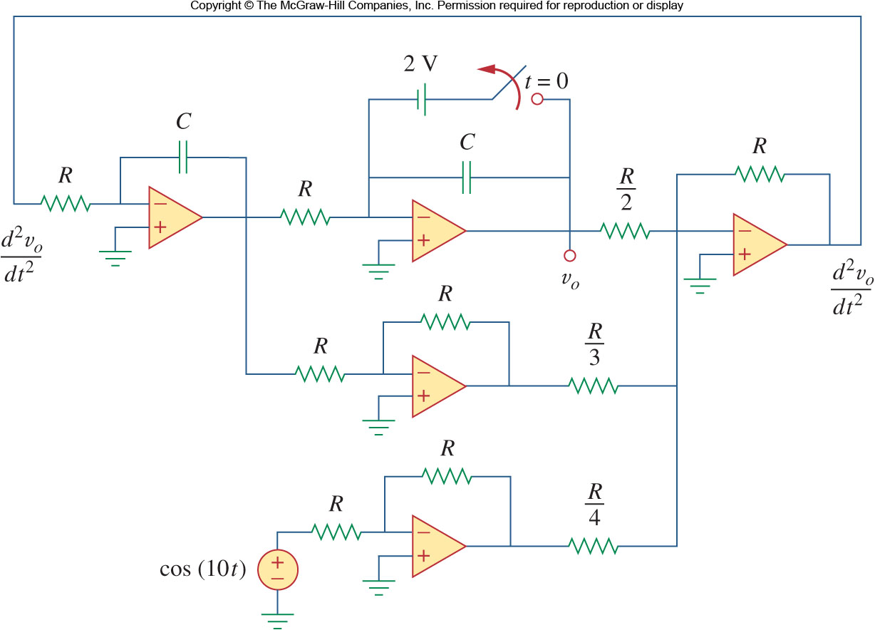
Figure 6.41

Slide 47
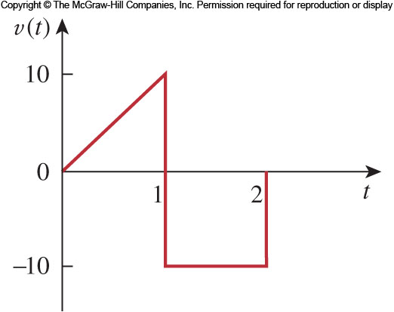
Figure 6.42

Slide 48
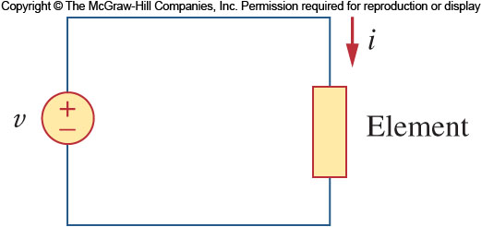
Figure 6.43

Slide 49
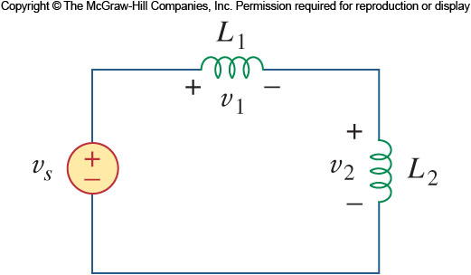
Figure 6.44

Slide 50
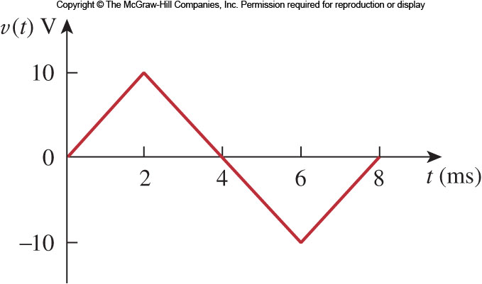
Figure 6.45

Slide 51
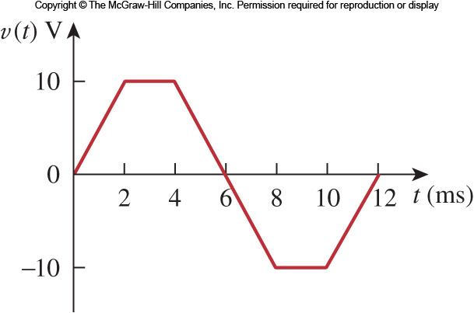
Figure 6.46

Slide 52

Figure 6.47

Slide 53

Figure 6.48

Slide 54

Figure 6.49

Slide 55

Figure 6.50

Slide 56

Figure 6.51a

Slide 57

Figure 6.51b

Slide 58

Figure 6.51c

Slide 59

Figure 6.52

Slide 60

Figure 6.53

Slide 61

Figure 6.54

Slide 62

Figure 6.55

Slide 63

Figure 6.56

Slide 64

Figure 6.57

Slide 65

Figure 6.58

Slide 66

Figure 6.59

Slide 67

Figure 6.60

Slide 68

Figure 6.61a

Slide 69

Figure 6.61b

Slide 70

Figure 6.62

Slide 71

Figure 6.63

Slide 72

Figure 6.64

Slide 73

Figure 6.65

Slide 74

Figure 6.66

Slide 75

Figure 6.67

Slide 76

Figure 6.68

Slide 77

Figure 6.69

Slide 78

Figure 6.70

Slide 79

Figure 6.71

Slide 80

Figure 6.72

Slide 81

Figure 6.73

Slide 82

Figure 6.74

Slide 83

Figure 6.75

Slide 84

Figure 6.76

Slide 85

Figure 6.77a

Slide 86

Figure 6.77b

Slide 87

Figure 6.78

Slide 88

Figure 6.79

Slide 89

Figure 6.80

Slide 90

Figure 6.81

Slide 91

Figure 6.82

Slide 92

Figure 6.83

Slide 93

Figure 6.84

Slide 94

Figure 6.85

Slide 95

Figure 6.86

Slide 96

Figure 6.87

Slide 97

Figure 6.88

Slide 98

Figure 6.89

Slide 99

Figure 6.90

Slide 100

Figure 6.91a

Slide 101

Figure 6.91b

Slide 102

Figure 6.92

Slide 103

Figure 6.93

Slide 104

Figure 6.94a

Slide 105

Figure 6.94b

